Slide 1
HIRING FOR KEEPS

Slide 2
Agenda + Workbook
A New Way to Hire
Crafting a Great Interview
The Interview/Doc Review
Q&A / Prizes
All information presented is owned by Leadershift. Content cannot be duplicated or distributed without permission.

Slide 3
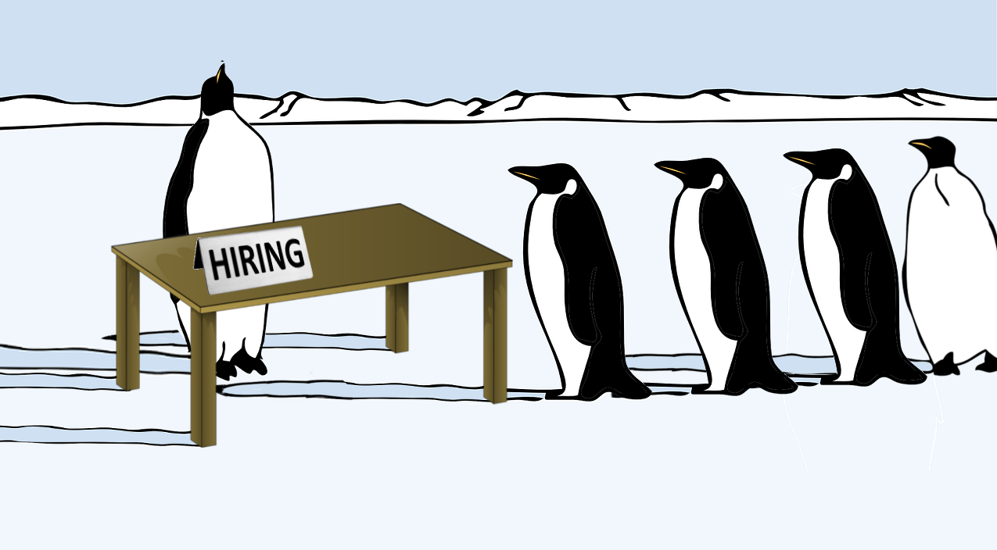
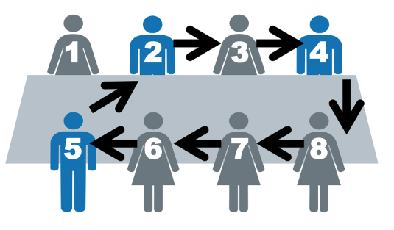
HIRING
By DEFAULT, we hire based on skill
Notes:
it’s hard, we don’t like doing it, we want it over. Ask: "What's the biggest challenge you face in the area of hiring right now?“

Slide 4
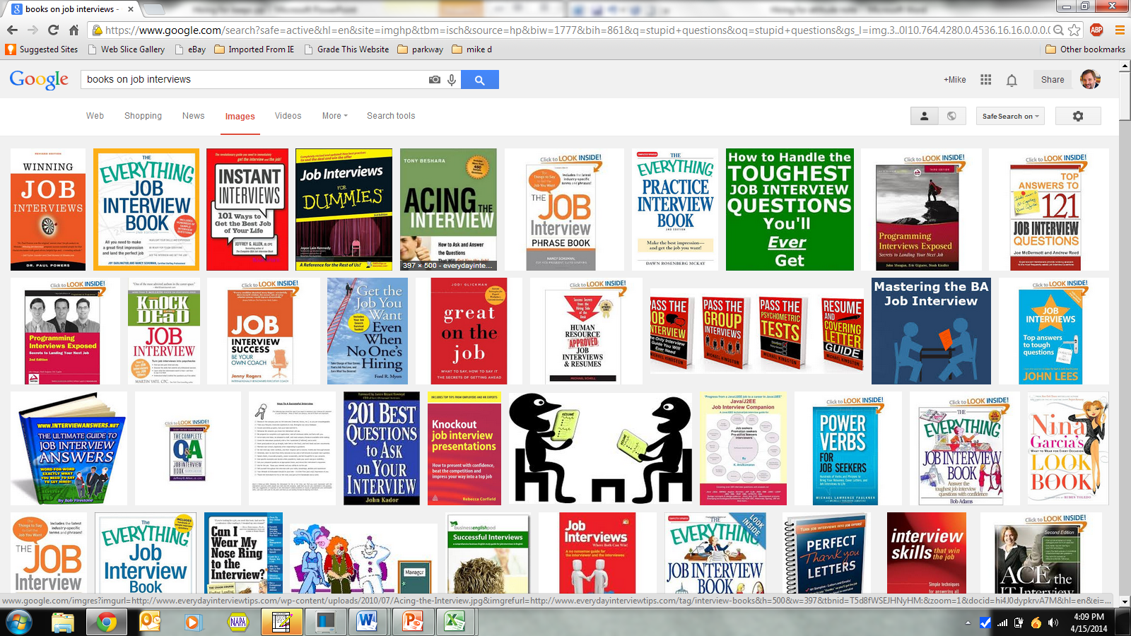
Is there help for the candidate?
4

Slide 5
1. You are legally accountable for the conduct of every person you hire.
Notes:
American Aitlines The U.S. Transportation Department announced a $50 million fine Wednesday against American Airlines over allegations it mistreated passengers with disabilities, which the department said in some cases caused injuries.

Slide 6
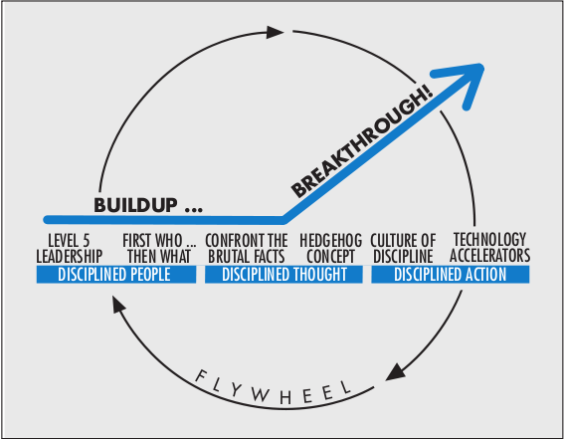
WHAT TODAY IS ABOUT
2. It’s the who before the what.
3. Hire disciplined people.
6
Notes:
For companies that went from good to great:
1) Hired disciplined people
2) You have disciplined thought
3) Breakthrough happened during the thought process
4) Disciplined action happened

Slide 7
GREAT COMPANY EQUATION
GREAT COMPANY =
Right people
+
4. vigorous debate
7
Notes:
Your team should consist of people who debate vigorously in search of the best answers yet unify behind decisions regardless of their interests.

Slide 8
PEOPLE are your most important asset.
5.The right

Slide 9
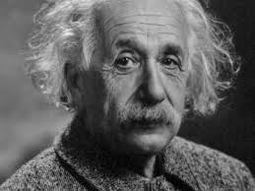
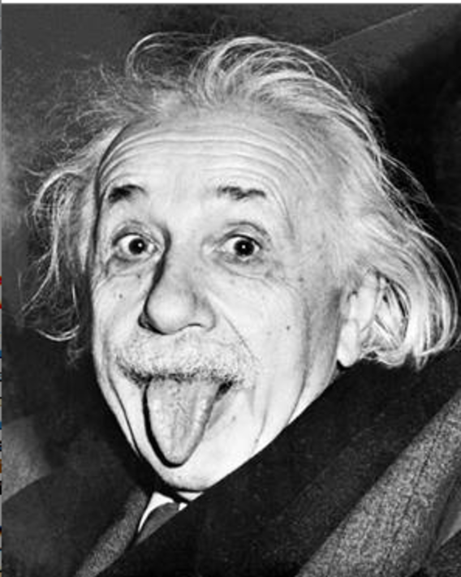
SIMPLE TRUTH
6. We hire people for
what they know.
7. We fire them for
who they are.
Notes:
Whether someone is the right person has more to do with character traits than with specific knowledge, background, or skill.

Slide 10
THE CHARACTER ICEBERG
Ability 10%
Knowledge & Skills
(Resume)
8. How I think you expect me to act.
9. How I really act.
Character 90%
Values, Wants, & Behaviors

Slide 11
FINDING THE 90%
10. We must change how we interview and how we listen to their answers
When we do this…
…We discover the real person.
Notes:
Value is hard to determine but affords more insight into who they really are.
When we change how we interview and how we listen to their answers…

Slide 12
11. Character drives behavior
Notes:
We tend to hire based on knowledge, background, and skill. (CLICK)
But the attitude iceberg indicates that whether someone is the right person has more to do with character traits than with specific knowledge, background, or skill.
Character drives behavior.

Slide 13
TALENT
“I’m a better coach of good players”- Lou Holtz
Talent matters.
12. Talent is what you can do.
13. Character determines what you will do.
You need both.

Slide 14
In the interview, there are TWO types of people
LOW PERFORMER (Lp)
HIGH PERFORMER (HP)
14. Problem bringers:
You will hear about the problem and nothing more.
15. Problem solvers:
You will hear about the problem and the solution.
Notes:
Story of developing a system for wheel installation

Slide 15
TWO TYPES OF PEOPLE
LOW PERFORMER (Lp)
HIGH PERFORMER (HP)
16. Don’t learn.
17. Learn

Slide 16
TWO TYPES OF PEOPLE
LOW PERFORMER (Lp)
HIGH PERFORMER (HP)
18. Talk about other people and the future.
19. Talk about themselves and the past (what they learned from their experience).
Notes:
We wanted to find out what a person learned from failures.

Slide 17
WHAT IS A LOW PERFORMER? (workbook, p. 6)
They want individual recognition
When faced with something new, they make excuses as to why it won’t work
Are quick to blame and eager to escape accountability
Throw up their hands, resist, and complain
Will have a negative disposition
Push back
Find ways to blame someone else for all the problems
Don’t follow thru
Are argumentative
Highly sensitive
Struggle to communicate across functional lines

Slide 18
WHAT IS A HIGH PERFORMER? (workbook, p. 7)
Highly collaborative
Help each other W/O being asked
Recognition is not required
Self-directed learners
Quick to get the information they need if they don’t know something
Are not interested in finding a source to blame
Proactively acquire new skills
Have a positive disposition
Go and figure out what to do
Ask questions to gain greater clarity
Go out of their way to support their peers
Follow thru and are serious about company promises
Choose their words carefully and help solve problems
Hear and respond with needed changes
Adapt to overcoming hurdles

Slide 19
ALIGNMENT
20. We can change skill levels,
21. But we can’t change character.
Alignment in character is a non-negotiable.

Slide 20
LEADERSHIP MOMENT
22. What are the characteristics we want to hire?
23. Describe an identifiable action that demonstrates these characteristics.
24. Who in the organization have you seen do this?

Slide 21
CRAFTING A GREAT INTERVIEW
Ask questions to reveal character. This:
Fosters openness
Recreates a scene
Unpacks their 90%
EXAMPLE: Could you tell me about a time when you lacked the skills or knowledge to complete an assignment?
Notes:
Combine slide 21 and 22

Slide 22
ASKING THE RIGHT QUESTIONS
DO
DON’T
25. Ask cliffhanger questions
Remove clauses:
…and how did you resolve it?
…and did so successfully?
26. Lead the witness
Ask hypotheticals
Ask legally problematic questions

Slide 23
Could you tell me about a time that a decision felt risky or you thought you might fail?
Lp
HP
Notes:
Play it safe and rarely take risks.
Take risks even if it means failing.
NOTE: Place the LP & HP list in the workbook.

Slide 24
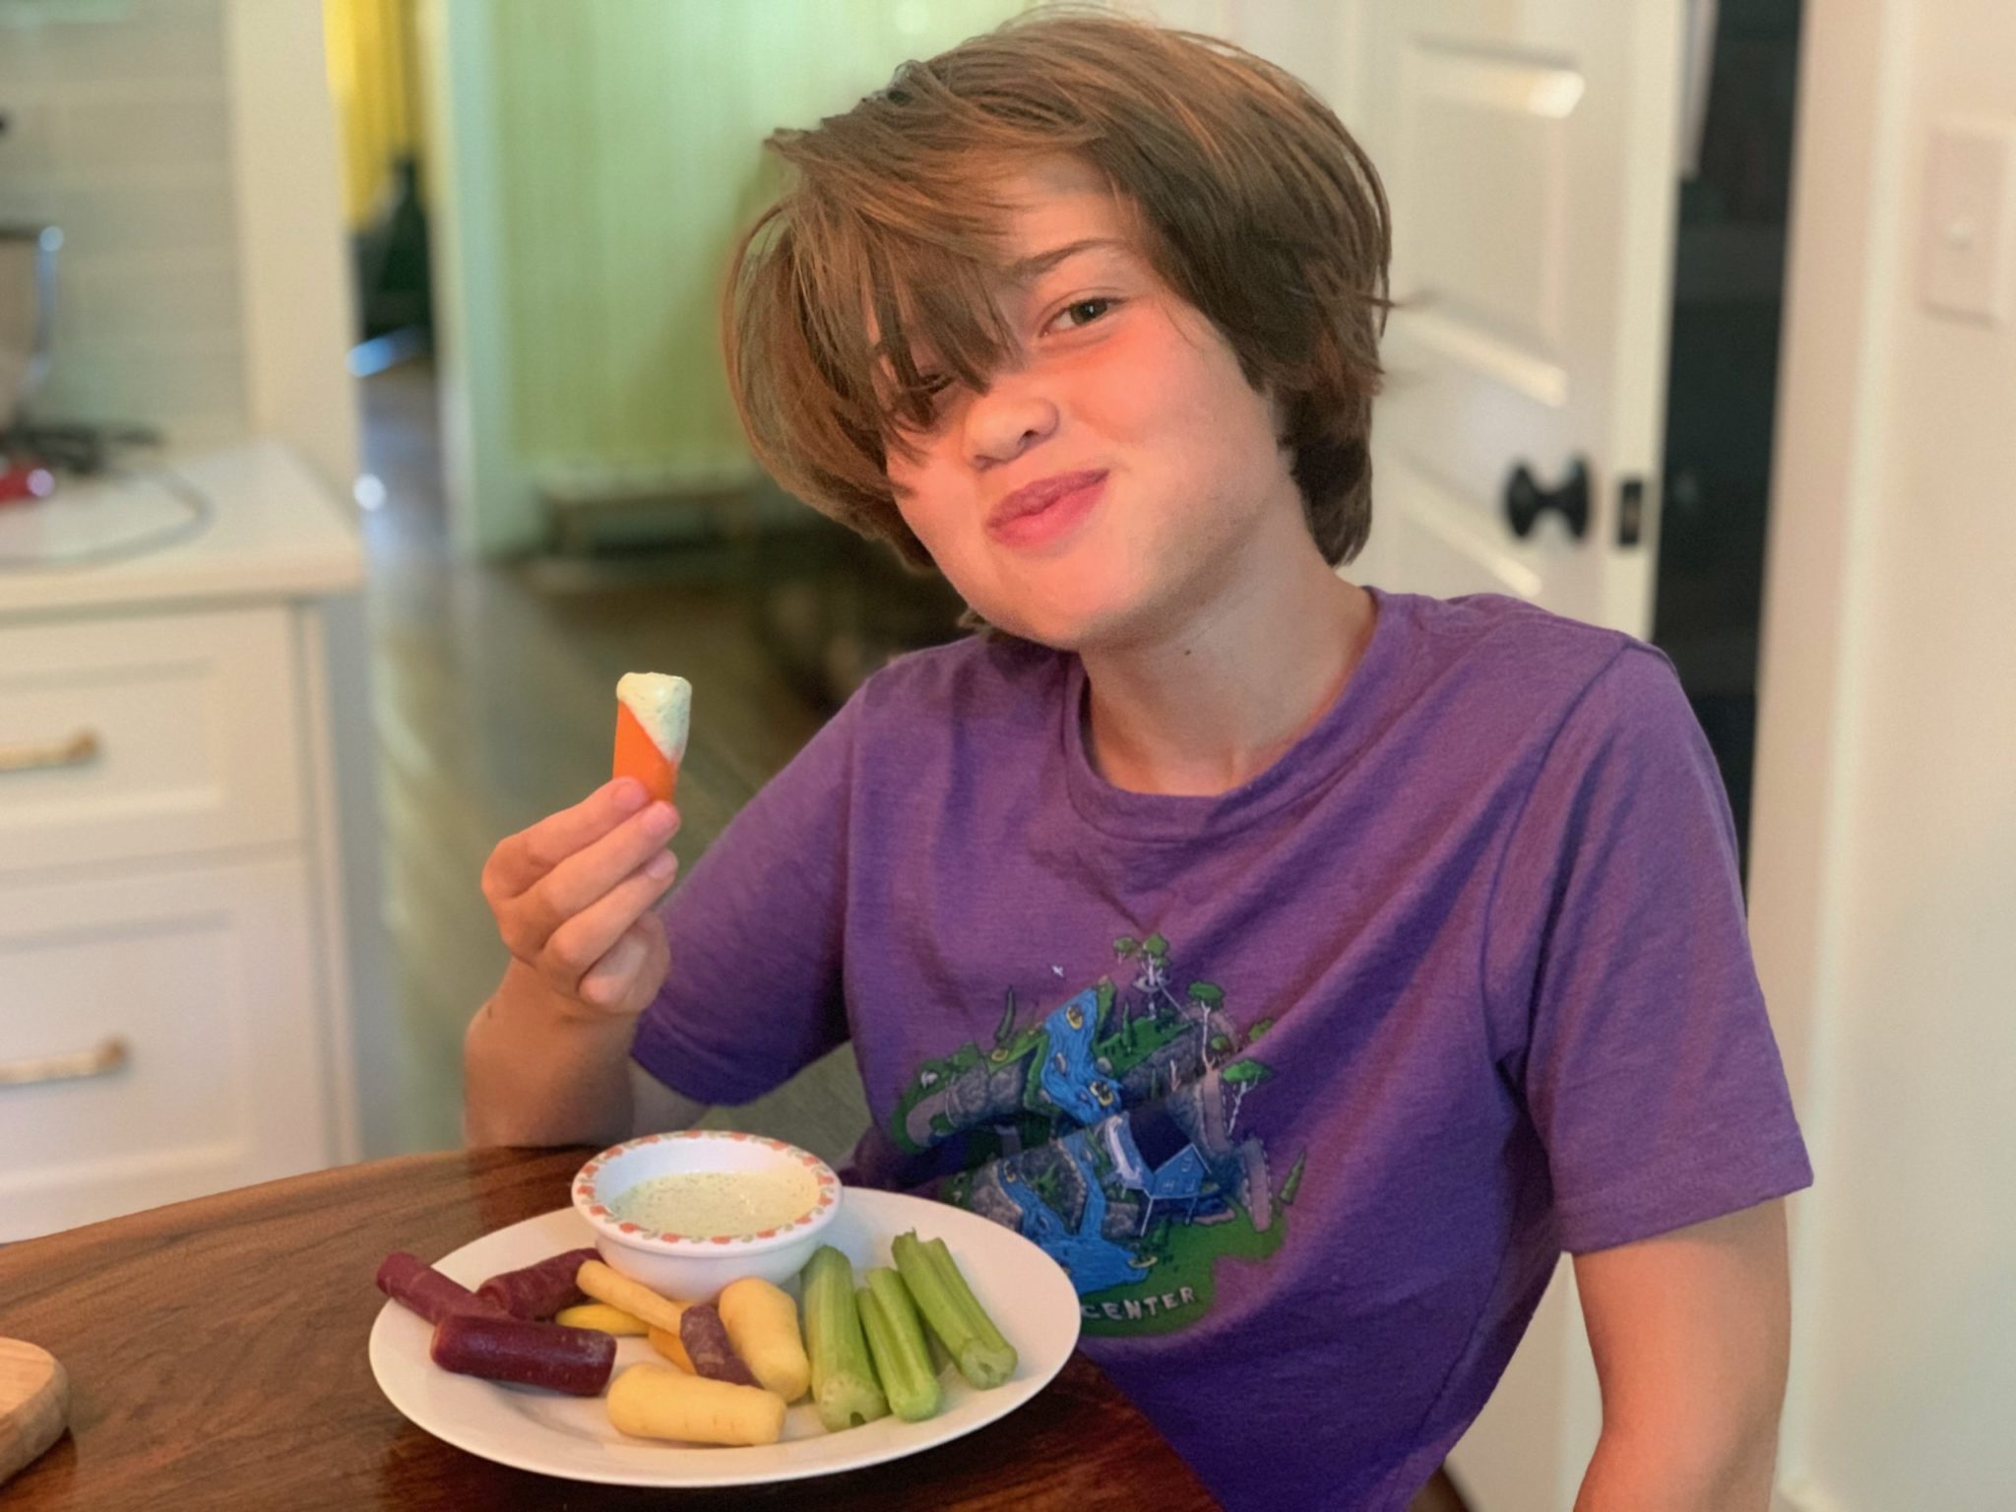
Could you tell me about a time when organizational rules created a barrier to achieving an outcome you wanted?
Lp
HP
Notes:
Lp – Complain about the rules.
HP - Respect the rules and look to improve them.

Slide 25
Could you tell me about a time you received negative feedback from a boss?
Lp
HP
Notes:
Lp – Highly sensitive
Hp – Hear and respond with needed changes
BETTER PICTURE – SOMEONE WHO IS LISTENING

Slide 26
LEADERSHIP 101
27. I’m the problem with my organization.
28. I’m also the solution.
29. Identify the actions YOU want to see happen inside your business (think non-negotiables)

Slide 27
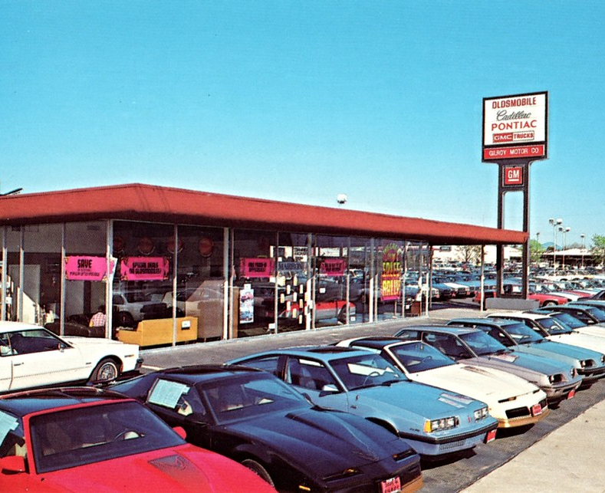
Character / Skill – “WASH THE TRUCK”
30. Teach employees what is acceptable/unacceptable.
We as leaders expect people to know what things are good and what things are bad.
31. Only 46% of employees scored high on this statement:
“I know what is expected of me at work – Gallup, 2024

Slide 28
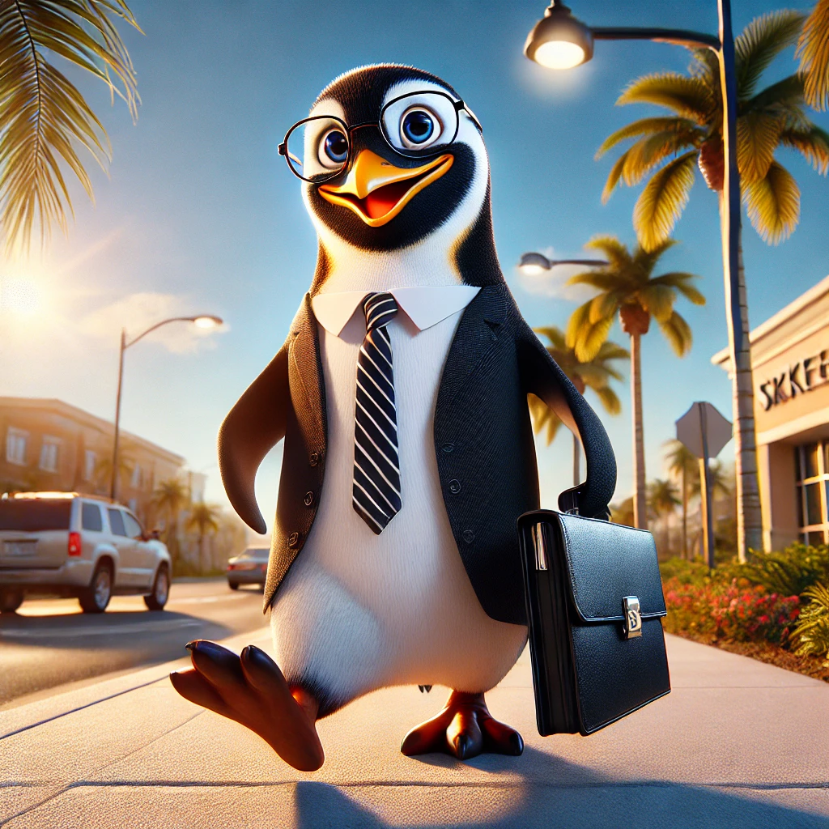
LET’S GET GREAT AT HIRING CHARACTER…
Notes:
If we need a penguin we know what a penguin looks like and what he must be able to do. When we find one we hire him

Slide 29
The Interview

Slide 30
HFK PROCESS TO FOLLOW (workbook, p. 10 and following)
Step 1: Pre-Screen
Step 2: Employment Application
Step 3: Interview
Step 4: Staff Interview
Step 5: Hire!
Step 6: Employee Evaluation
Step 1: HFK Prescreen Questionnaire
Step 2: HFK Employment Application
Step 3: HFK Interview Questions
Steps 4 & 5 (action steps)
Step 6: HFK Employee Evaluation
Notes:
Check to make sure downloads still work.
We will only cover number 1- and let it describe the other steps of development.

Slide 31
What questions can we answer?

Slide 32
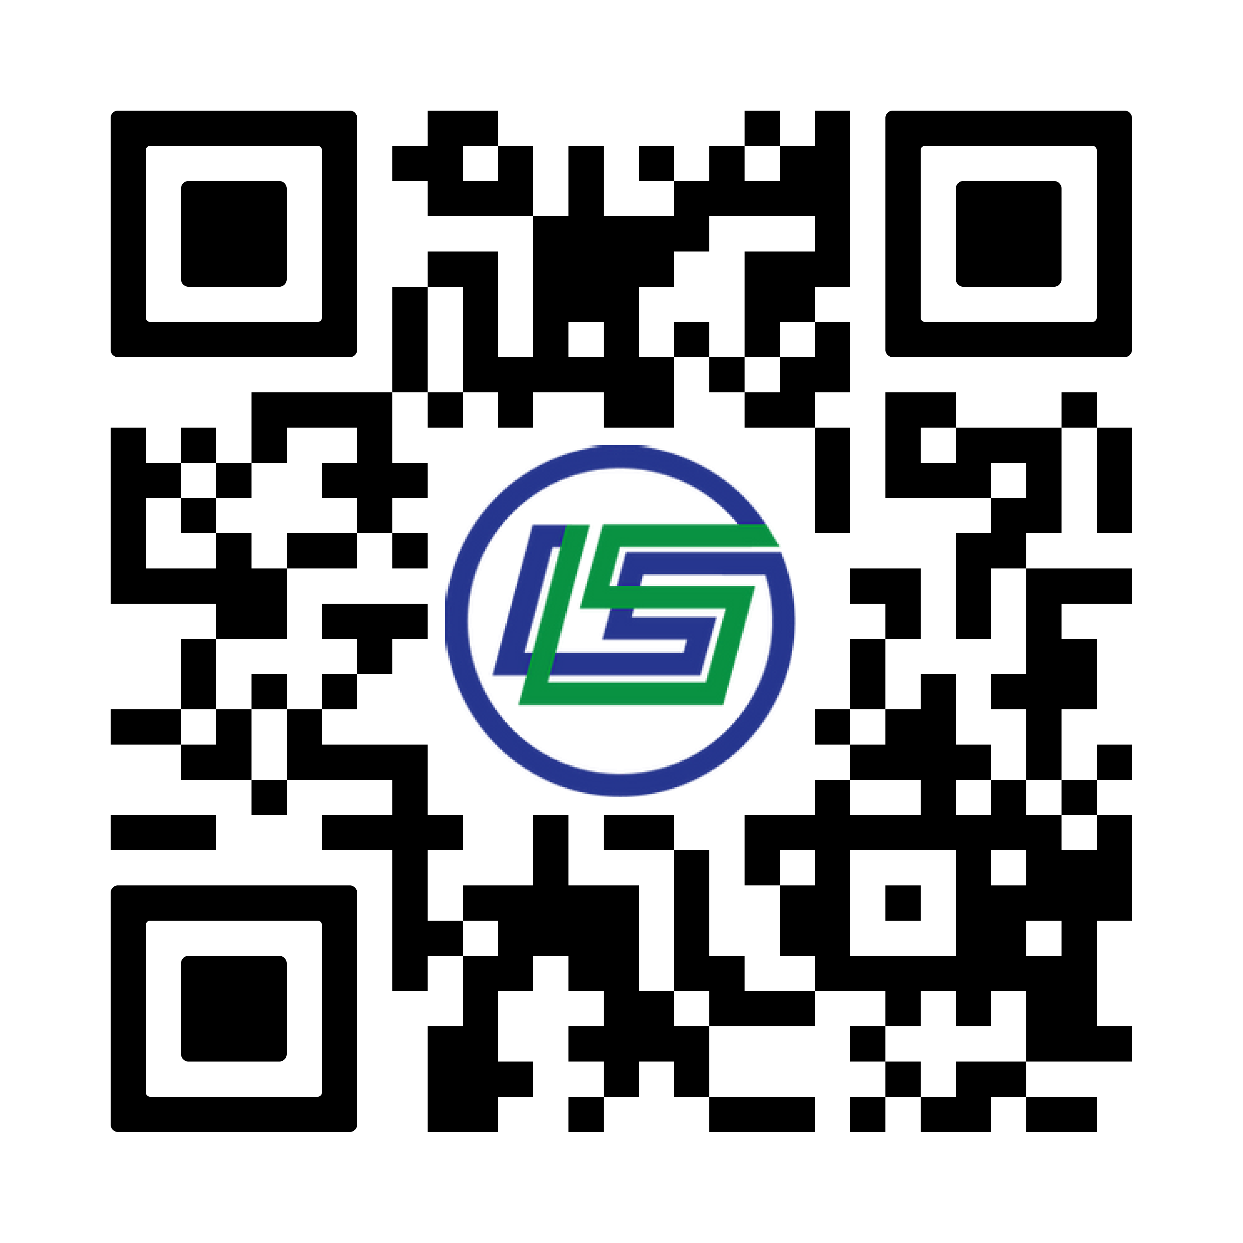
WAYS WE CAN HELP
Personal Leadership Training (online)
1-on-1 Coaching (online)
Team Development (in-person/online)
Personalized Workshops (in-person/online)
Succession Planning
HFK Implementation
Moments with Mike (email)
Notes:
Check to make sure downloads still work.
We will only cover number 1- and let it describe the other steps of development.

Slide 33
Thank You! (+ Prizes)
All information presented is owned by Leadershift. Content cannot be duplicated or distributed without permission.

